Slide 1
US Layoff Analysis - Modelling and Application of Project Results
Likhita Alla Sravani yalamarthi
Saint Peter’s University
DS-670-HYB2-25SPTR: Capstone: Big Data & Data Science
Professor- Reda Mastouri
March 16, 2025

Slide 2
Introduction
The US job market has been undergoing drastic changes in employment trends influencing business and policy makers.
Economic downturns, technological shifts, corporate restructuring, and shifts in market demand lead to job loss.
It will enable them to recognize causes and anticipate redundancies in order to take preventive action in an attempt to curb workforce volatility.
It applies machine learning techniques to analyze patterns in GV Data and Telemetry layoffs in DOGE.
There are 14,499 records of separation in the data set with details on job category, pay grade, employee status and reasons for separation.
Objective: To reveal patterns in layoffs and test the predictive power of multiple machine learning algorithms in predicting job separation. This work can be used to inform workforce planning, improve job security, and allow policy makers to develop better labor policies (Saba, 2024).

Slide 3
Data Preparation
Challenges in raw data are missing values, inconsistencies, and imbalanced class distributions.
Steps taken to preprocess and clean data:
Removed duplicate records to prevent model bias.
Filled in missing numerical values (such as "Pay Grade") with the median.
Filled in missing category values (such as "Reason" and "Employee Status") with the most common category.
Developed features such as "Separation Year" in order to study layoff patterns over time.
Added "Recent Layoff" (binary variable) to highlight layoffs in 2018 and beyond.
Applied one-hot encoding on the categorical features to maintain data integrity.
Tackled class imbalance by utilizing Synthetic Minority Over-sampling Technique (SMOTE) and resampling methods (Singh & Tiwari, 2025).

Slide 4
Machine Learning Models Used
StandardScaler used for numerical feature scaling.
Data split: 80% training, 20% testing.
Model | Algorithm Type | Key Parameters | Advantages
Logistic Regression | Linear Model | Max Iterations = 1000 | High interpretability
Random Forest | Ensemble (Bagging) | Trees = 100 | Handles non-linearity, reduces overfitting
Extra Trees | Ensemble (Bagging) | Trees = 100 | Faster than Random Forest, better generalization
Gradient Boosting | Ensemble (Boosting) | Trees = 100, Learning Rate = 0.1 | Improves weak learners iteratively

Slide 5
Model Implementation
Logistic Regression: Simple and interpretable but had convergence issues.
Random Forest: Worked well with non-linearity and coped with missing values very well.
Extra Trees Classifier: Provided quicker computations and slightly better generalization.
Gradient Boosting: Improved classification with iterative learning but required excessive hyperparameter adjustment.
Hyperparameter tuning: Grid Search and Randomized Search were employed in order to optimize model performance (Zhang & Han, 2024).

Slide 6
Model Evaluation
Best Performing Model: Random Forest with the highest accuracy rate (81.0%) and precision rate (77.2%).
Gradient Boosting had the highest AUC but had to be tuned.
Logistic Regression fared worse because it wasn't able to deal with complex feature interactions (Naidu et al., 2023).
Model | AUC | Precision | Accuracy | MAE | MSE | RMSE
Logistic Regression | 0.889 | 0.735 | 0.746 | 1.91 | 15.66 | 3.95
Random Forest | 0.913 | 0.772 | 0.810 | 1.52 | 12.79 | 3.57
Extra Trees | 0.908 | 0.768 | 0.805 | 1.55 | 13.04 | 3.61
Gradient Boosting | 0.920 | 0.760 | 0.799 | 1.59 | 13.33 | 3.65

Slide 7
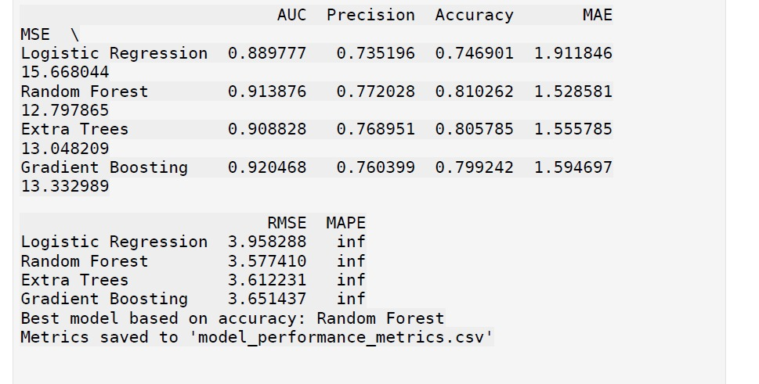
Model Evaluation

Slide 8
Findings and Key Insights
Key Determinants of Layoffs:
The Separation year
Department
Employee status
Key Findings:
Random Forest and Extra Trees methods based on trees produced the highest accuracy.
Logistic Regression had significant problems with feature complexity.
Ensemble methods reduced overfitting and encouraged improved generalization.
Implications for Organizations:
Companies can actively assess workforce reduction risks.
HR departments can employ predictions in order to optimize talent retention programs.
Policymakers can develop better labor market policies (Naidu et al., 2023).

Slide 9
Conclusion & Recommendations
Conclusion:
Machine learning algorithms can efficiently forecast patterns of layoffs.
Random Forest becomes the leading model for predicting layoffs.
Recommendations
Use Random Forest as a baseline model for workforce analysis in the future.
Augment dataset by including economic indicators such as GDP growth and inflation.
Explore deep learning models including XGBoost and neural networks for greater accuracy.
Implement real-time workforce tracking tools in human resources systems.
Train human resources professionals to use predictive insights in making decisions.

Slide 10
Reference
Naidu, G., et al. (2023). A review of evaluation metrics in machine learning algorithms. Computer Science Online Conference. https://doi.org/10.1007/978-3-031-35314-7_2
Saba, Z. (2024). Layoffs and corporate performance: evidence based on the US tech industry. Journal of Economics and Finance, 48(3), 644-667. https://doi.org/10.1007/s12197-024-09673-y
Singh, Y., & Tiwari, M. (2025). A Comprehensive Machine Learning Approach for Early Detection of Diabetes. SN Computer Science, 6(3), 213.
https://doi.org/10.1007/s42979-025-03751-6
Zhang, C., & Han, W. (2024). Ensembles of decision trees and gradient-based learning for employee turnover prediction. PeerJ Computer Science, 10, e2387.
https://peerj.com/articles/cs-2387/

